Slide 1
Collective excitations in competing phases in two and three dimensions
arxiv.org/abs/2403.18701
Joshua althüser, AG Uhrig

Slide 2
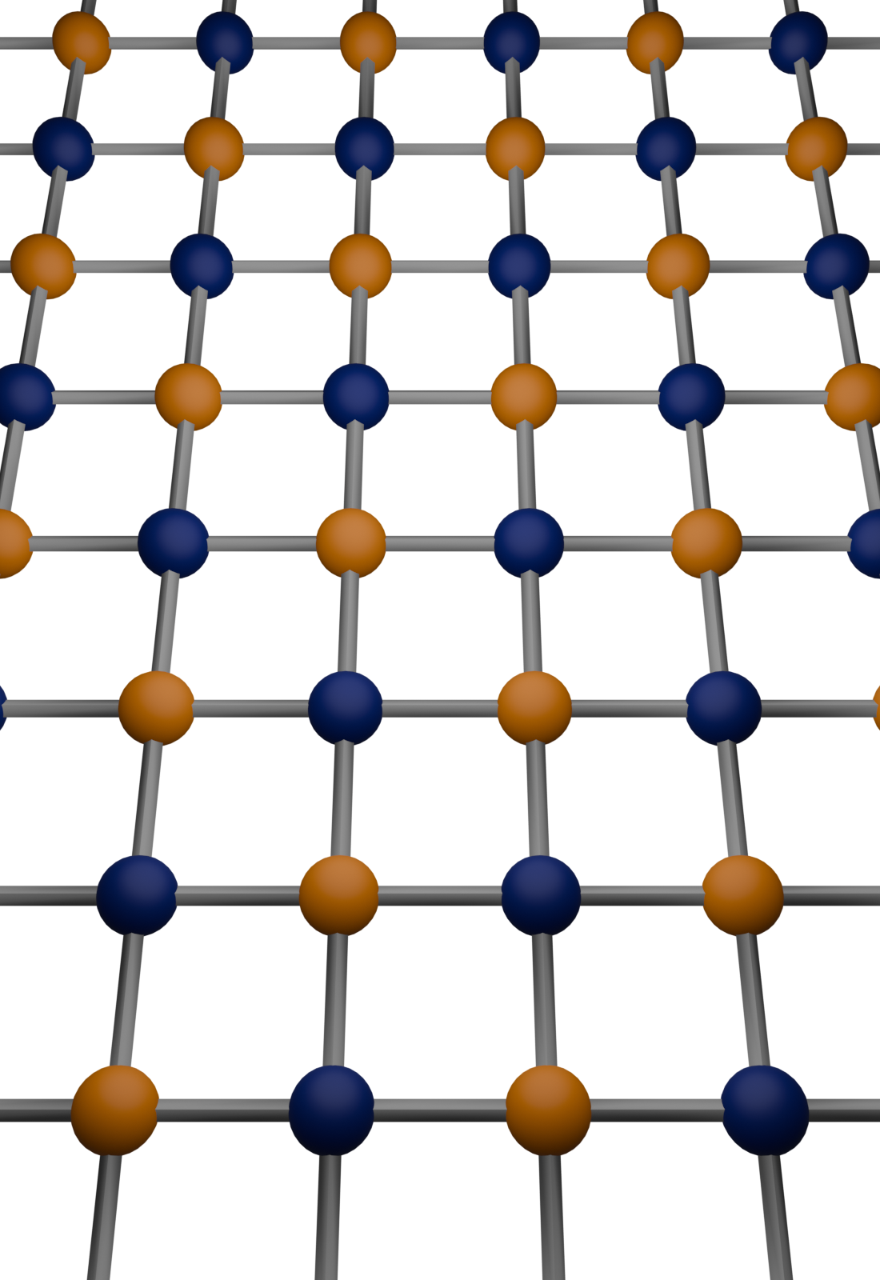
Introduction
We aim to describe collective behavior
Track excitations across phase transitions
Are there precursors, e.g., modes that become soft?
We will investigate
Superconducting systems (SC)
Antiferromagnetic systems (AFM)
Charge-density-wave systems (CDW)

Slide 3
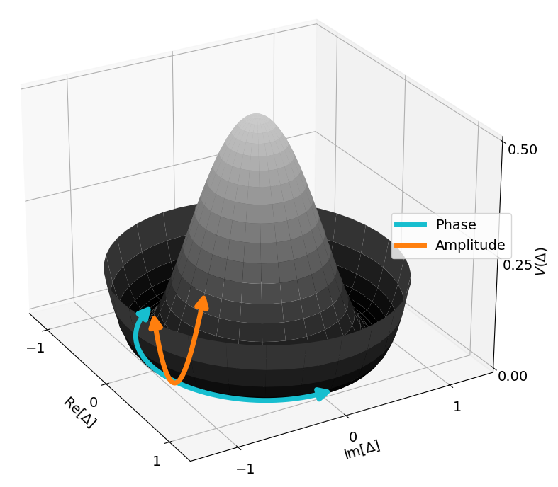
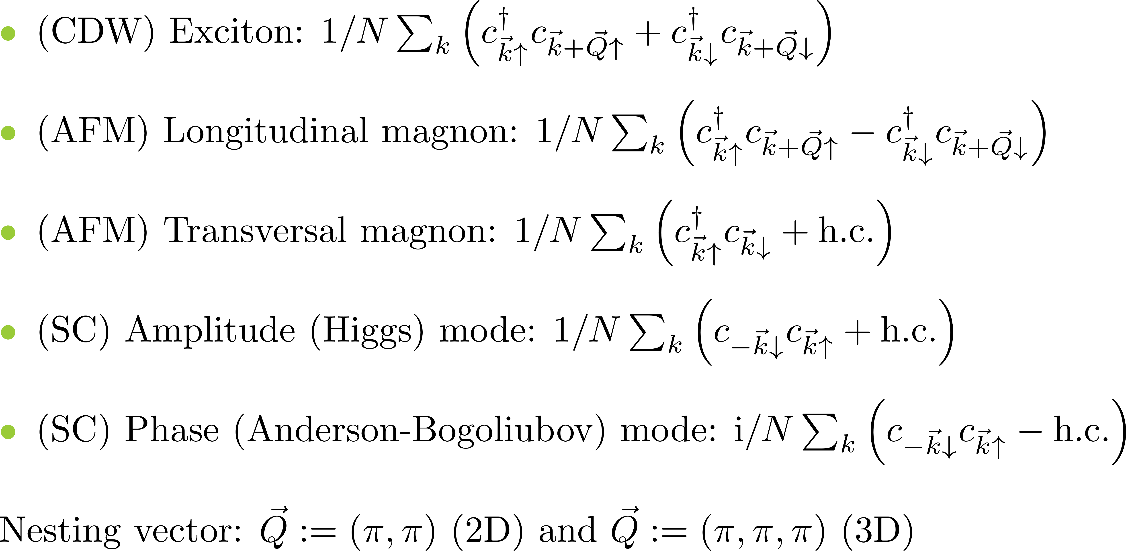
Observables of interest

Slide 4
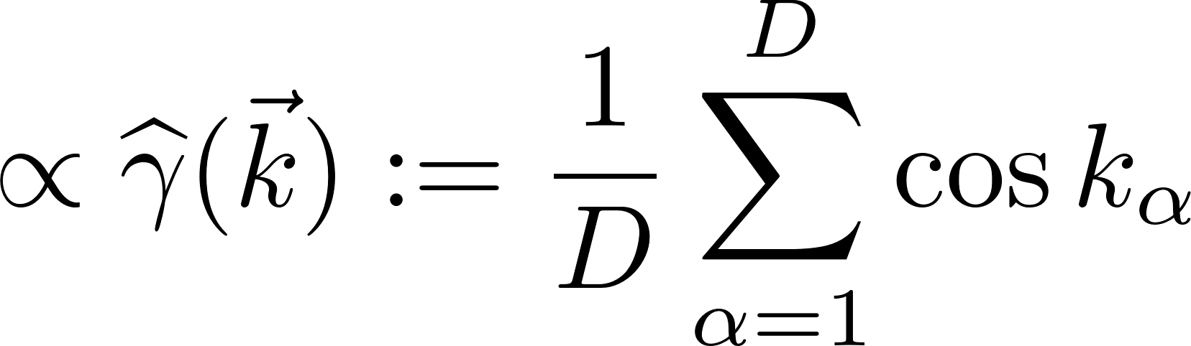
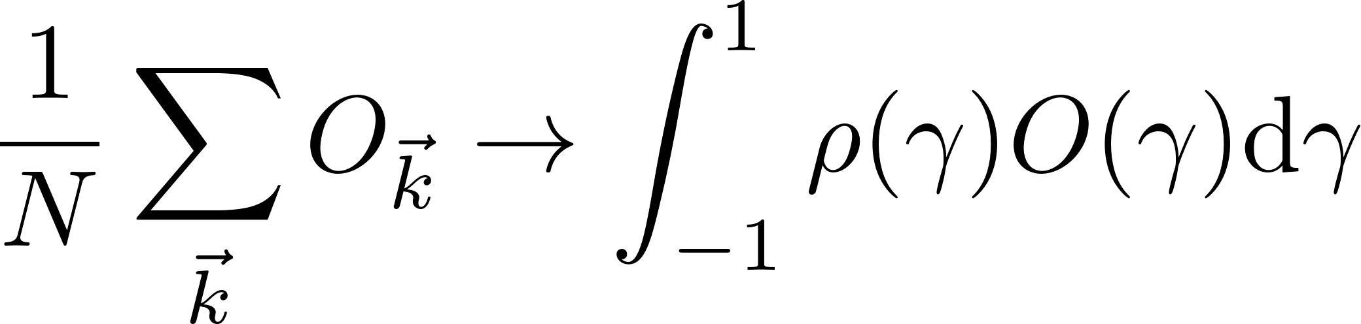
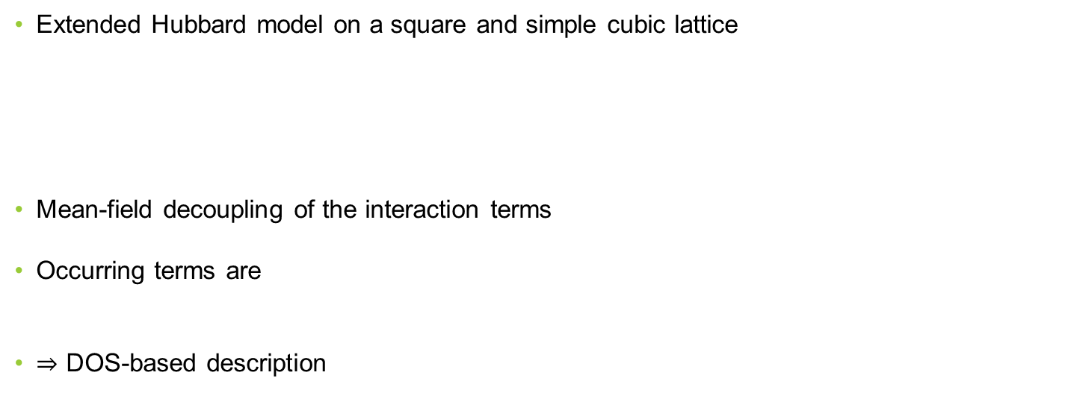
Model
Extended Hubbard model on a square and simple cubic lattice
Mean-field decoupling of the interaction terms
Occurring terms are
$⇒$ DOS-based description

Slide 5
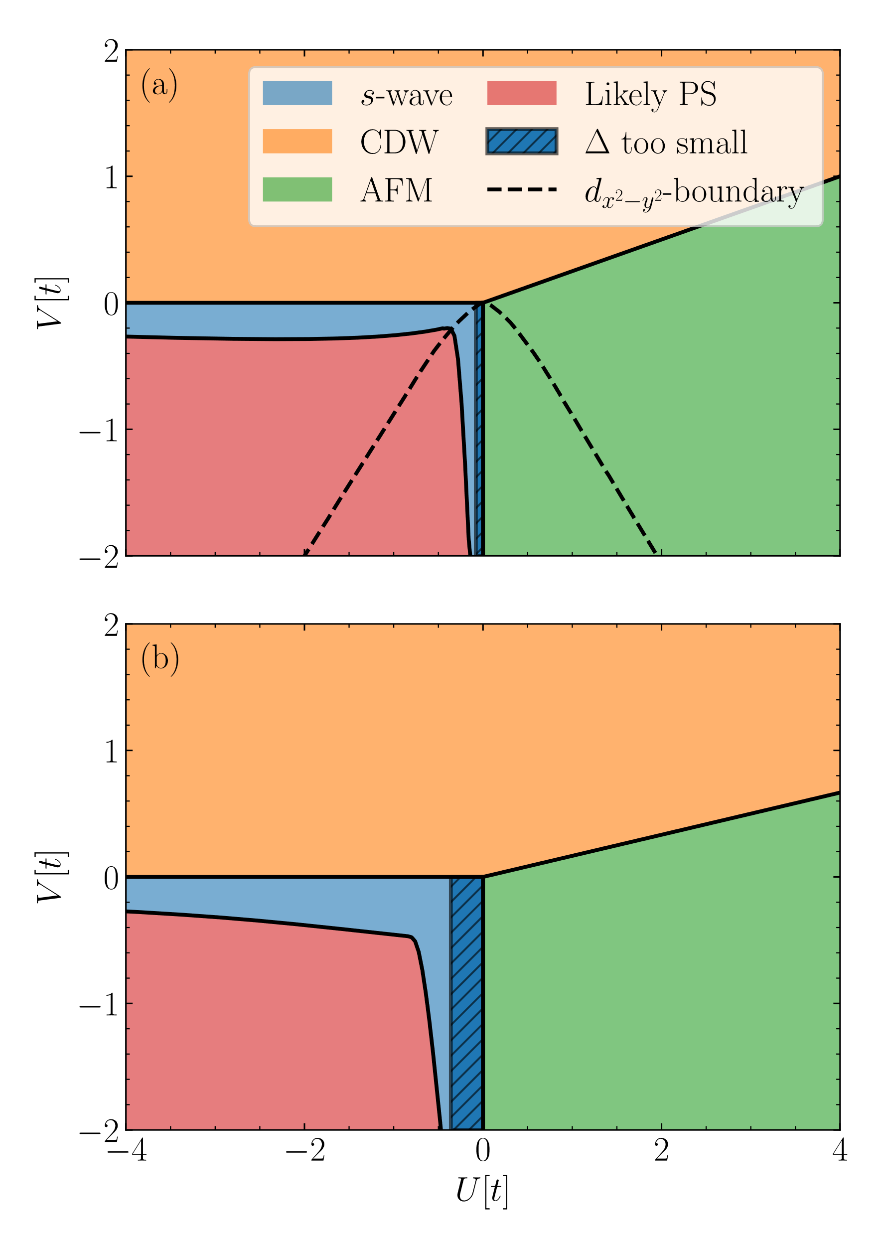
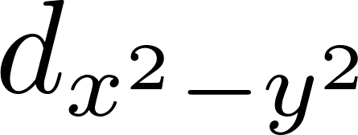

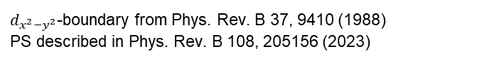
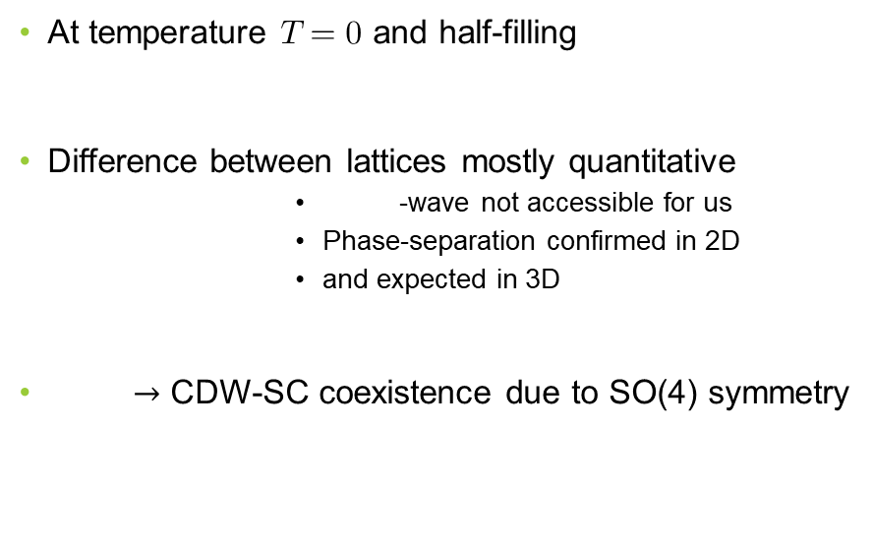
Mean-field phase diagram
At temperature $T=0$ and half-filling
Difference between lattices mostly quantitative
-wave not accessible for us
Phase-separation confirmed in 2D
and expected in 3D
$→$ CDW-SC coexistence due to SO(4) symmetry
$d_{x^{2}−y^{2}}$-boundary from Phys. Rev. B 37, 9410 (1988) PS described in Phys. Rev. B 108, 205156 (2023)

Slide 6
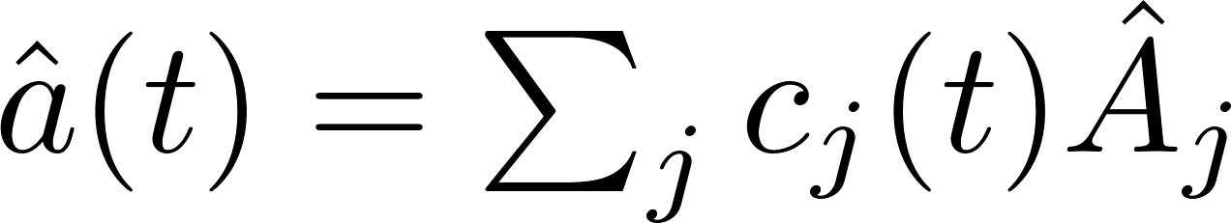
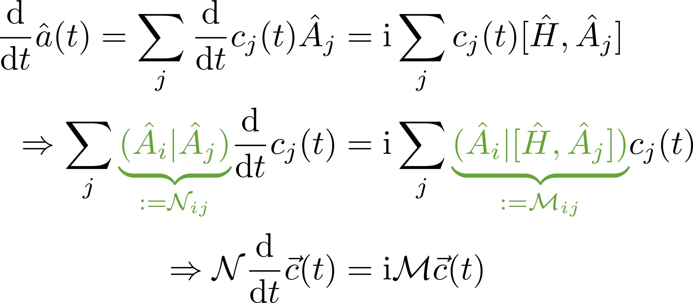
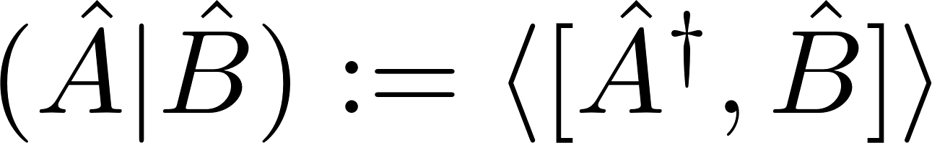
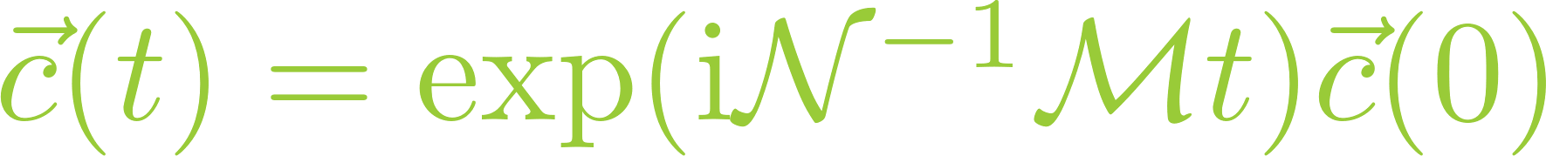
Method: Iterated equations of motion
Consider a time-dependent operator
With the symplectic product

Slide 7
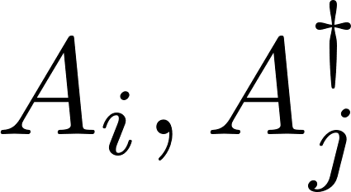
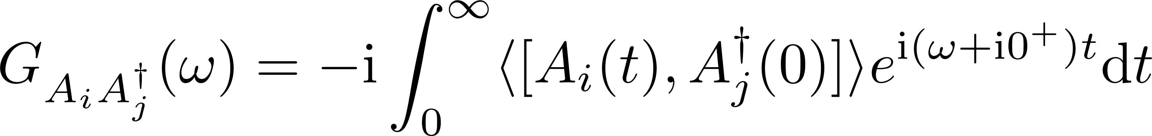
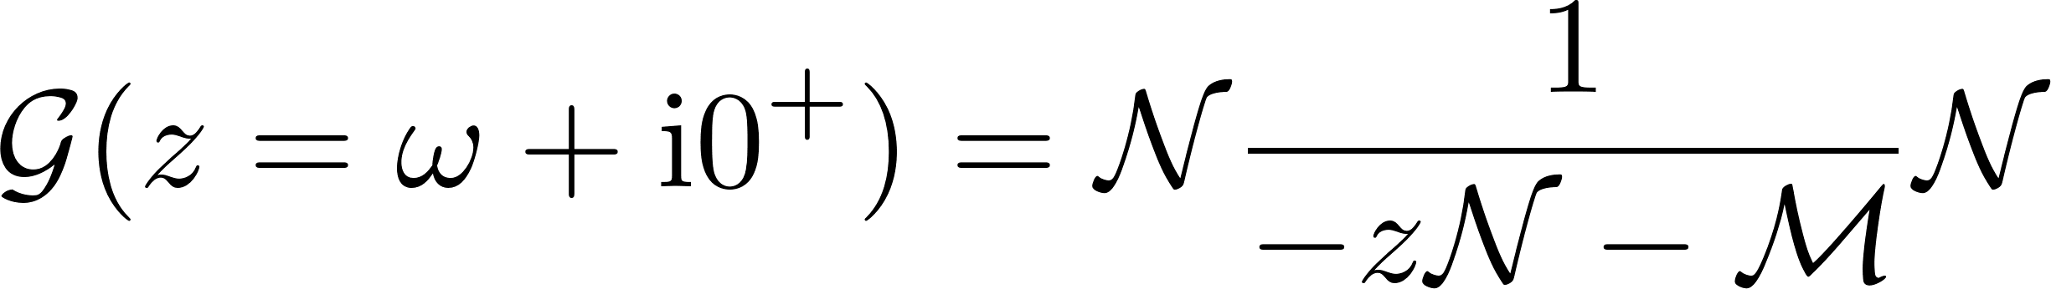
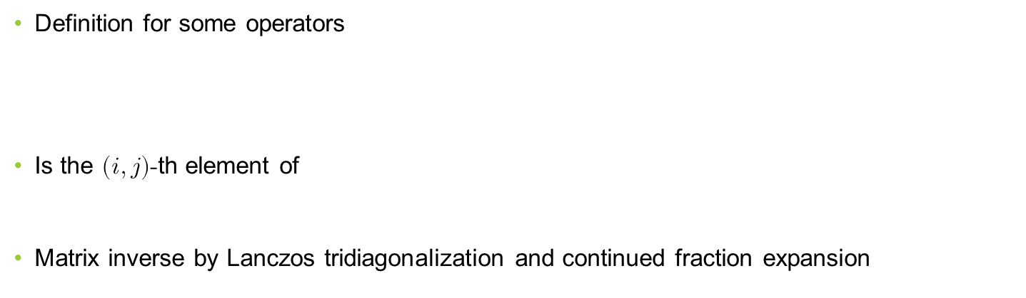
Green‘s functions
Definition for some operators
Is the $(i, j)$-th element of
Matrix inverse by Lanczos tridiagonalization and continued fraction expansion
Powerful method for computing various Green‘s functions!

Slide 8
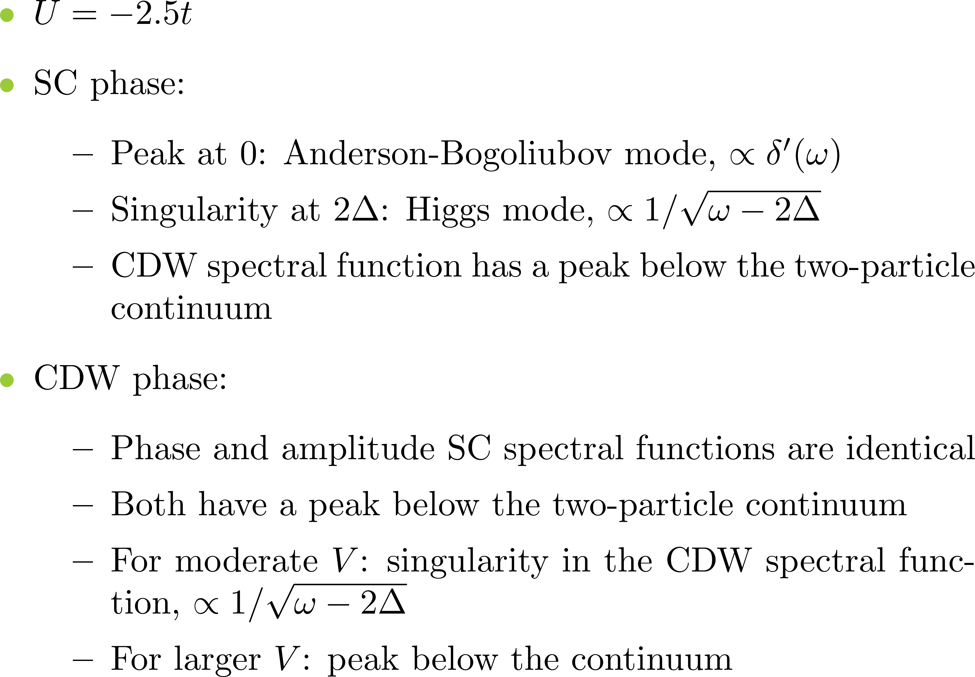
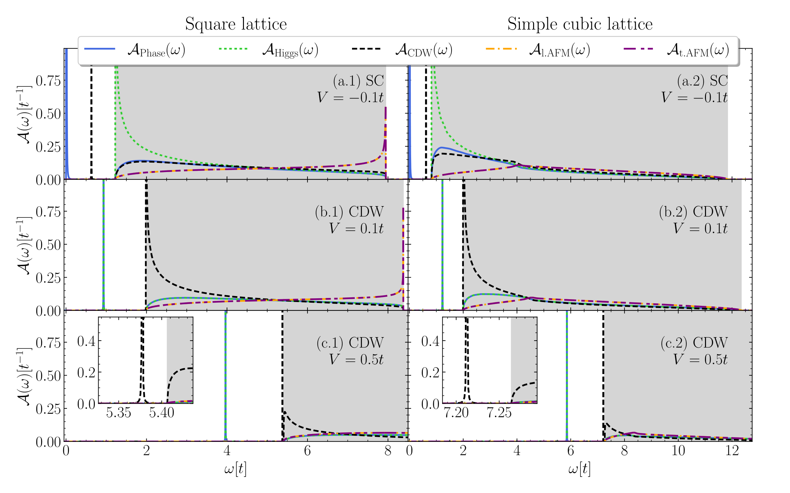
CDW-SC transition

Slide 9
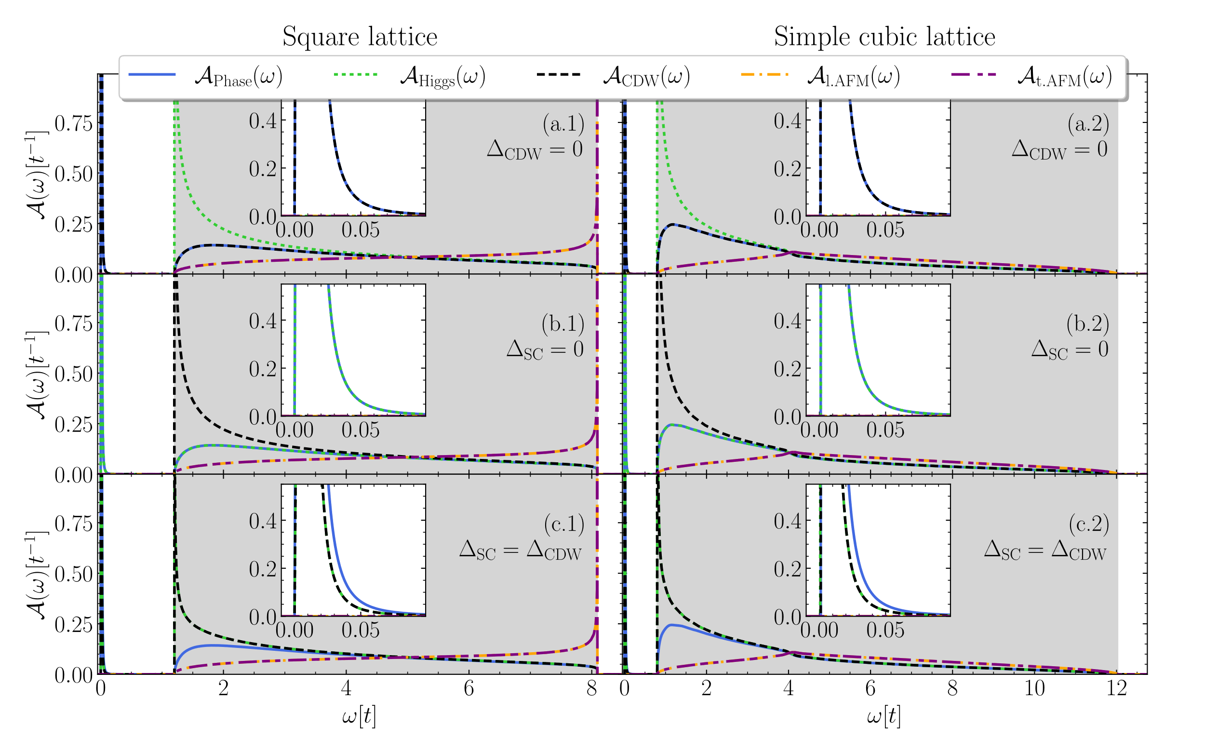
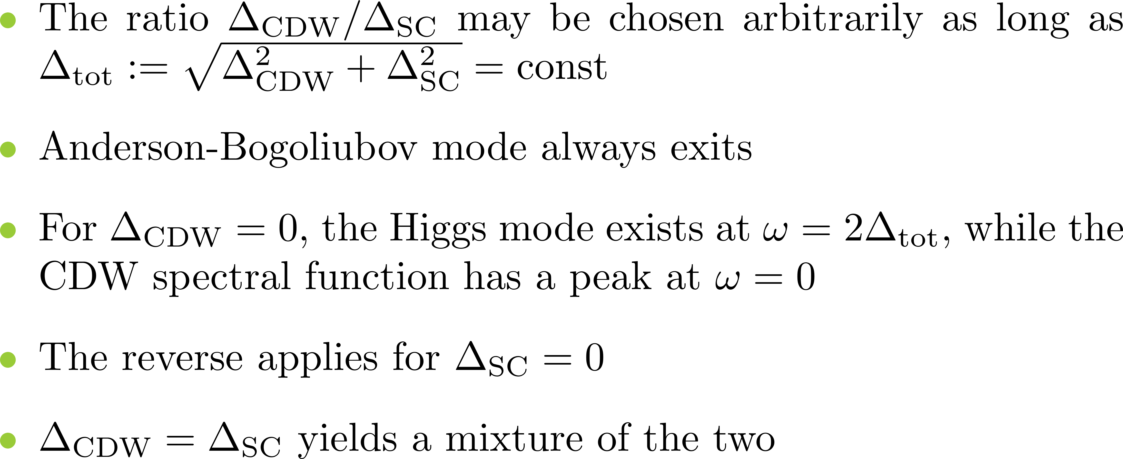
CDW-SC coexistence

Slide 10
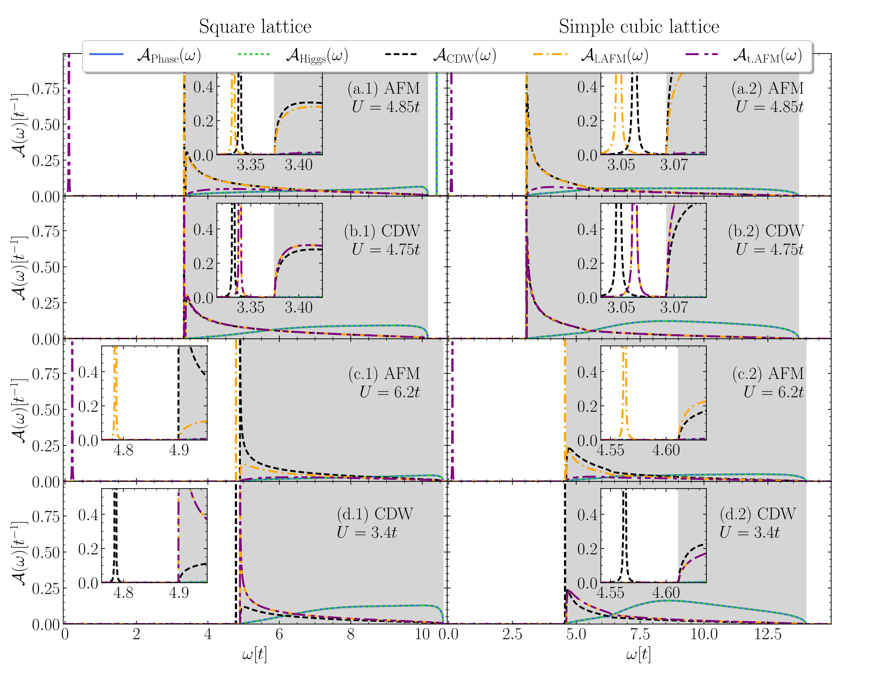
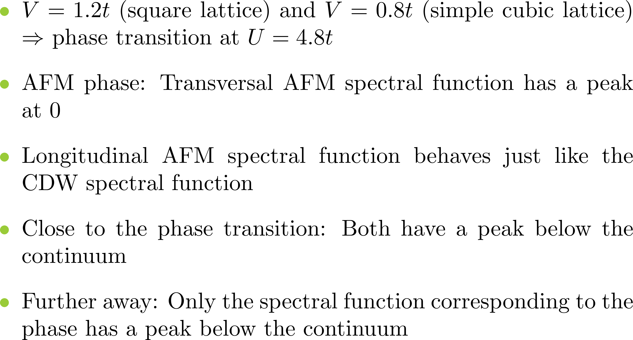
AFM-CDW transition

Slide 11

Conclusion
Outlook
Demonstrated a powerful method for computing Green‘s functions
Used it to find and describe various collective excitations
Followed their behavior as the system‘s parameters are changed
Incorporate long-range electromagnetic interactions
Investigate more intricate systems, e.g., multiband system
Compute the dispersions of various collective modes
Our results can be found on https://arxiv.org/abs/2403.18701

